Slide 1
PHP in the Cloud
Juozas “Joe” Kaziukėnas
http://juokaz.com / juozas@juokaz.com / @juokaz

Slide 2

Who is this guy?
Juozas Kaziukėnas, Lithuanian
You can call me Joe
3 years in Edinburgh, UK
CEO of Web Species Ltd
Occasional open source developer
Conferences speaker
More info in http://juokaz.com
Tweet me @juokaz

Slide 3

CLOUD

Slide 4

Someone’s imagination?

Slide 5
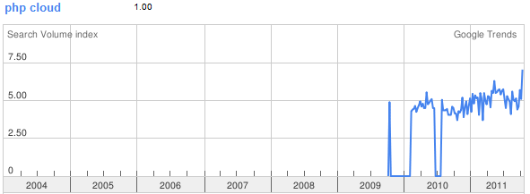
Came to PHP in 2010*

Slide 6
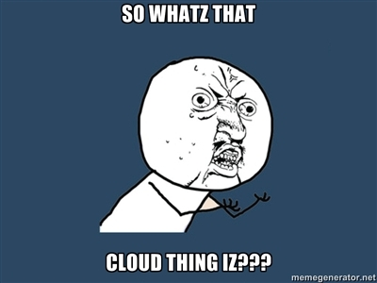

Slide 7
What cloud means
“A model for consumption & delivery on the internet where ﬂexibility is essential & can be guaranteed through abstraction” – Thijs Feryn

Slide 8

Enough of this *cloud*

Slide 9
IF YOU TAKE ONE thing out of this presentation
What would THAT be?

Slide 10
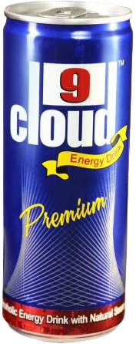
Cloud drinking game
Every time someone says “cloud”, take a drink

Slide 11

Layers
IaaS
PaaS
SaaS

Slide 12
Iaas vs Paas
Multiple apps per instance
Freedom to configure
Unmanaged
Learning steps
Hybrid cloud
One app per instance
Pre-configured system
Managed
Out of the box
Super cool

Slide 13

Why would I want that?

Slide 14
You want this because
Abstraction
Flexibility
Agile
Scale: vertical or horizontal
It sells nowadays

Slide 15
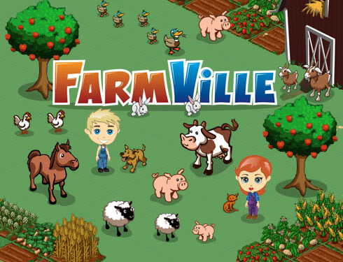
Zynga case

Slide 16

Cloud ready app
Any app deployed to the cloud – not really what cloud is for
Cloud can be just a host, but it’s more
If you don’t need elasticity…
Use surrounding services
Storage
Database
Queues
Etc.

Slide 17
Clouds
Amazon EC2
Microsoft Windows Azure
Rackspace
Gazillion more

Slide 18
clouds
Custom setup
Learning curve
Unmanaged cloud
Can take a lot of hoops

Slide 19
setting servers up is not easy
Your business is to create apps

Slide 20

This talk is about PaaS

Slide 21
PHP community moving
We decided to create our own clouds
On top of existing platforms
Optimized and made easier for PHP developers
We know how to make PHP work well
Community support

Slide 22





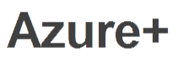
PHP clouds

Slide 23
PHP clouds
Similar approaches
Deploy from Git/SVN or push
Very simple to deploy
Cheap to run
Out of the box support for tools and frameworks
Horizontal scaling

Slide 24
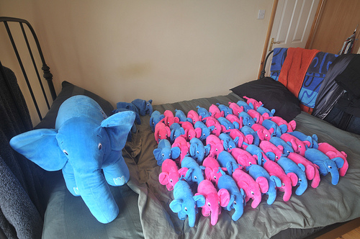
How it works

Slide 25

Let’s deploy
So you want to deploy to a cloud…

Slide 26
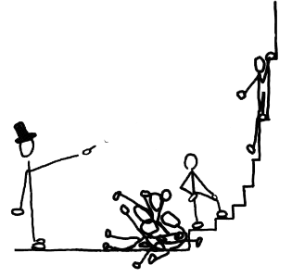
Let’s deploy
If internet works
Simple PHP app deployed to
Orchestra
Azure+
This is so cool

Slide 27

Azure+ vs. Orchestra
Runs on Windows Azure
Microsoft SQL server
Deploy from GIT or push
Choose PHP version
In development
Runs on Amazon EC2
Mysql, MongoDB etc.
Deploy from GIT
PHP 5.3 (custom)
Stable

Slide 28

Hardcore deploy action

Slide 29

Pretty much any app will work, unless…

Slide 30
YOUR app should be…
Don’t use local disk/storage
Sessions
Files
Don’t expect things to exist
Latency between servers
Shared state
Abstract enough, no direct calls

Slide 31
Share nothing
Makes horizontal scaling impossible
State stored between server
Application files in network drive

Slide 32
Much more easier
If you use a framework
Stops you from doing stupid things
Abstract database interactions
Using ORM
Don’t try to do things with PHP which are not meant to be done

Slide 33
Leverage services
API wrappers and SDK available in PHP
Store files in CDN
Use cloud databases
Manage the service
Automate

Slide 34
Deploy
I like to push code
Deploy branch in a repository is fine too
Use automated scripts
Preconfigure apps
You don’t get access to PaaS servers
Forget about FTP

Slide 35
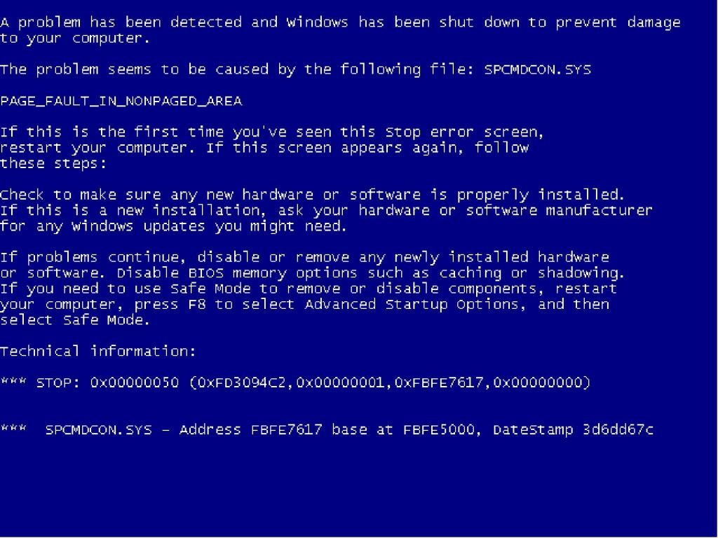

Slide 36

Unhappy cloud

Slide 37
Can be down
“A lightning strike in Dublin, Ireland knocked Amazon's European cloud services offline Sunday and some customers were expected to be down for up to two days” – Information Week

Slide 38
Can be down
“Sites across the U.S. went offline for up to 12 hours yesterday as Amazon's northern Virginia data centre was hit by a series of outages” – Daily Mail

Slide 39
Can be down
“During a routine operating system upgrade on Friday (March 13th), the deployment service within Windows Azure began to slow down due to networking issues. This caused a large number of servers to time out and fail” – MSDN blog

Slide 40
Unhappy cloud
It’s not magically reliable
It can be less reliable than on-premises server
Need multiple instances
Load balancer
Deploy across data centers
Hybrid cloud, again

Slide 41
Conclusion
Make a choice IaaS vs PaaS
Try out PaaS just for fun (doesn’t cost anything)
Write your apps correctly
Scale

Slide 42
Thank you!
Keep in touch
http://juokaz.com
juozas@juokaz.com
twitter: @juokaz
Rate at http://joind.in/4317

